Slide 1
Finding hope in a hopeless world
Session 6 – 5th Week of Lent
Why should I hope in the Church in 2024?
DIOCESE OF CORK & ROSS Lent 2024
Notes:
The Church in Ireland has seen many changes over the last number of decades. It is easy to focus only on the negative (the declining numbers of those attending Mass and liturgies, and an aging congregation and clergy). We might be tempted to look back with nostalgia to previous generations. It might even prompt us to ask the question, why should I hope in the Church in 2024?

Slide 2
Welcome and Prayer
Spend a few minutes greeting each other and sharing:
What stayed with you from last week’s gathering?
How did you put your reflection into action?
DIOCESE OF CORK & ROSS Lent 2024
Notes:
We will now continue with a breath awareness activity leading into our prayer time…
Breath awareness activity and prayer to the Holy Spirit
Sit comfortably and close your eyes... Take a few moments to simply be…. Notice whatever is being experienced in the moment - sounds, physical sensations, thoughts, feelings - without trying to do anything about it… Continue like this a little while, allowing yourself to settle down…
Bring your attention to your breath. Simply notice your breath as it moves in and out as your body inhales and exhales... Notice how your breath moves in and out automatically, effortlessly… Don’t try to change it in any way... Notice all the details of the experience of breathing - the feeling of the air moving in and out of your nose, the way your body moves as it breathes, etc.
Let all of your experiences - thoughts, emotions, bodily sensations - come and go in the background of your awareness of your breath... Notice how all of your experiences - thoughts, emotions, bodily sensations, awareness of sounds and smells - come automatically and effortlessly like the breath…
Bring your attention to breathing in… as you breathe in invite the Holy Spirit, the Spirit of hope, the Spirit of life, the Spirit of love into yourself… Come, Holy Spirit. Continue to call on the Holy Spirit in the silence of your hearts… God is always present to us… in this time we are inviting ourselves to become more present to Him…
Now we turn our attention to breathing out… what sort of a day have you had so far today… perhaps you have been very busy and this is your first opportunity to sit down… perhaps you have left so many chores and things to do behind you… we bring with us all our hopes and dreams, our worries and cares, and hand them over to our Heavenly Father confident that He loves us and holds us tenderly in His hands…
As you breathe in… welcome the Holy Spirit… as you breathe out… hand over your life to God who wills the best for you…
Come, Holy Spirit. Teach us, lead us and guide us during this time together. May we come to know God the Father’s love, mercy and compassion in a deeper way, and may we be filled with the hope that comes from knowing Jesus. We make our prayer, through Christ, our Lord. Amen.

Slide 3
Listening to God’s Word
“And they devoted themselves to the apostles’ teaching and fellowship, to the breaking of bread and the prayers… And all who believed were together and had all things in common; and they sold their possessions and goods and distributed them to all, as any had need. And day by day, attending the temple together and breaking bread in their homes, they partook of food with glad and generous hearts, praising God and having favor with all the people. And the Lord added to their number day by day those who were being saved.” (Acts 2:42-47)
DIOCESE OF CORK & ROSS Lent 2024
Notes:
Someone in the group may wish to read our Scripture piece. Then we will pause for a few moments and invite a second reader to read the same text. Ask if anyone would like to share their thoughts on God’s word. Please pause the video until this section is completed.

Slide 4
“And they devoted themselves to the apostles’ teaching and fellowship, to the breaking of bread and the prayers… And all who believed were together and had all things in common; and they sold their possessions and goods and distributed them to all, as any had need. And day by day, attending the temple together and breaking bread in their homes, they partook of food with glad and generous hearts, praising God and having favor with all the people. And the Lord added to their number day by day those who were being saved.” (Acts 2:42-47)
DIOCESE OF CORK & ROSS Lent 2024
Notes:
Let’s look again at this description of the Church in the Acts of the Apostles:
Which of these activities still take place today?
Was it easier or more difficult for them to practice their faith than it is for us today?
What challenges did the early Christians face?
How did the Church community support individuals in practicing their faith? How does the Church community today help us to practice and grow in our faith?

Slide 5
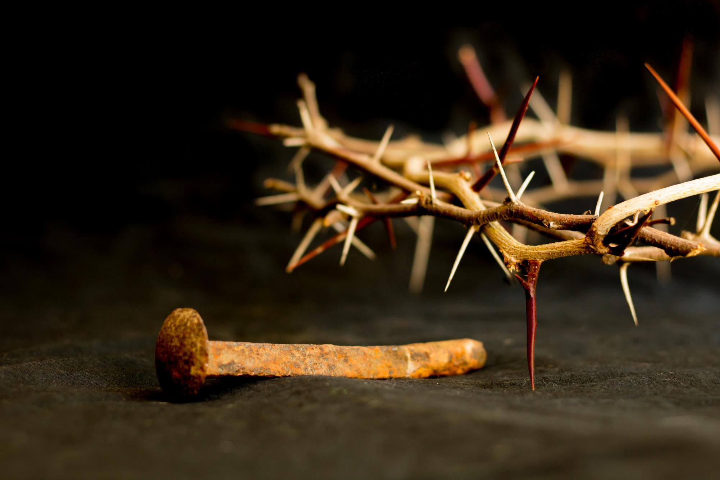
Notes:
We sometimes forget that Christians were persecuted from the earliest times.

Slide 6
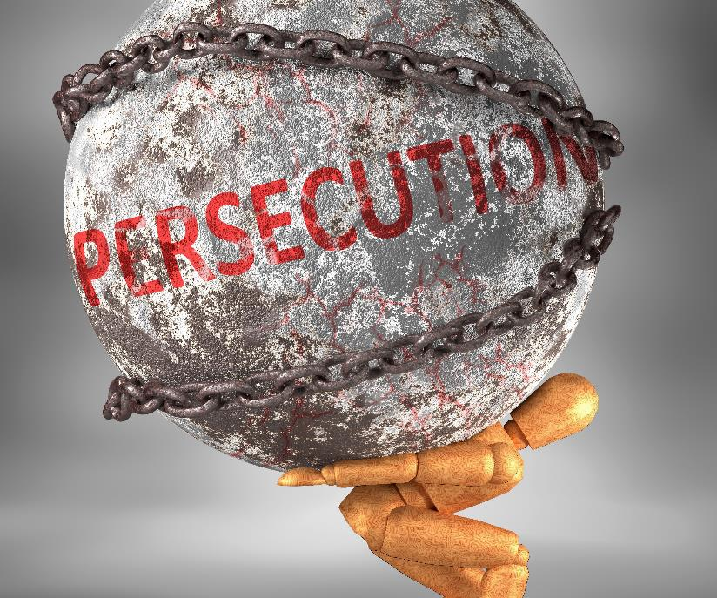
Finding hope in our Church
“Remember what I told you:
‘A servant is not greater than his master.’ If they persecuted me, they will persecute you also.”
(John 15:20)
DIOCESE OF CORK & ROSS Lent 2024
Notes:
Jesus warned us that there will be persecution.

Slide 7
Finding hope in our Church
“Blessed are those who are persecuted for righteousness’ sake,
for theirs is the kingdom of heaven.
Blessed are you when people revile you and persecute you
and utter all kinds of evil against you falsely on my account.
Rejoice and be glad, for your reward is great in heaven,
for so people persecuted the prophets who were before you.”
(Matthew 5:10-12)
DIOCESE OF CORK & ROSS Lent 2024
Notes:
But there will be hope, too.
Reflect for a moment: Why does Jesus say that we are blessed when we are persecuted in His Name?

Slide 8
Finding hope in our Church
“Truly, I say to you, there is no one who has left house or brothers or sisters or mother or father or children or lands, for my sake and for the gospel, who will not receive a hundredfold now in this time, houses and brothers and sisters and mothers and children and lands, with persecutions, and in the age to come eternal life.”
(Mark 10:29-31)
DIOCESE OF CORK & ROSS Lent 2024
Notes:
Jesus said we will receive all that we have forsaken a hundred times over even in this lifetime. How is that possible?

Slide 9
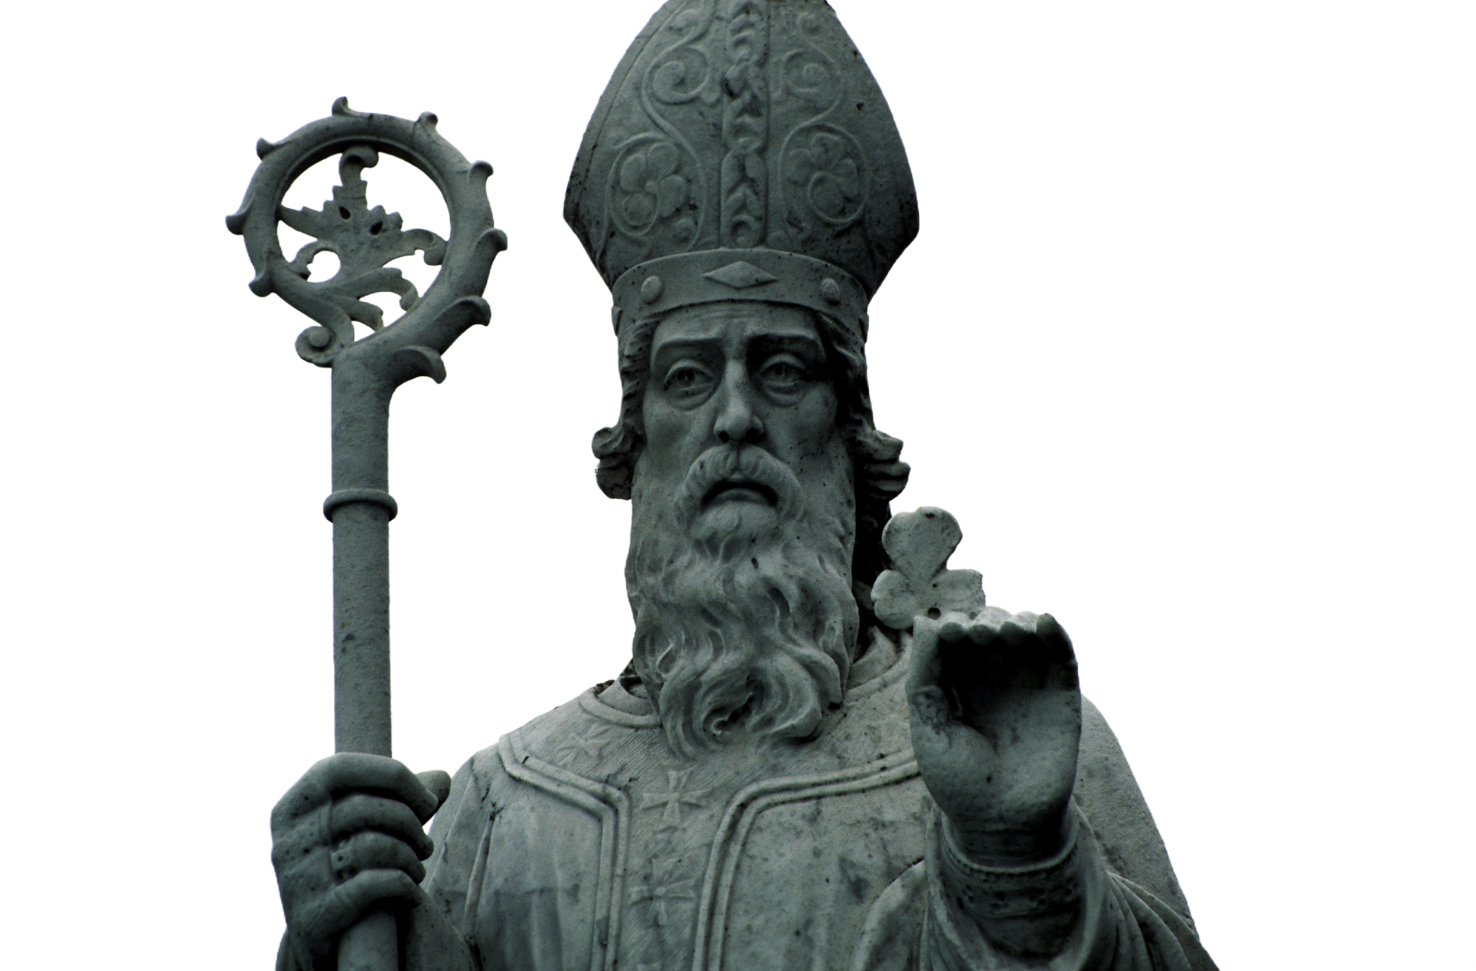
Notes:
This week we celebrate the feast of St. Patrick, our patron saint. St. Patrick is an example of one who left house or brothers or sisters or mother or father or children or lands, for the sake of Jesus and for the gospel.
When he was 16 years old, Irish raiders tore him from the villa of his father, Calpurnius, a deacon and minor local official, and carried Patrick into slavery in Ireland. He spent six bleak years here as a herdsman, during which time he turned with fervor to his faith.

Slide 10
St. Patrick and hopeful perseverance
“The Lord opened up my awareness of my lack of faith. Even though it came about late, I recognised my failings.
So I turned with all my heart to the Lord my God.”
(St. Patrick, The Confessions)
DIOCESE OF CORK & ROSS Lent 2024
Notes:
It was in slavery that he said, “the Lord opened up my awareness of my lack of faith. Even though it came about late, I recognised my failings. So I turned with all my heart to the Lord my God.” (St. Patrick, The Confessions). He found hope in his faith in the middle of persecution and adversity.

Slide 11
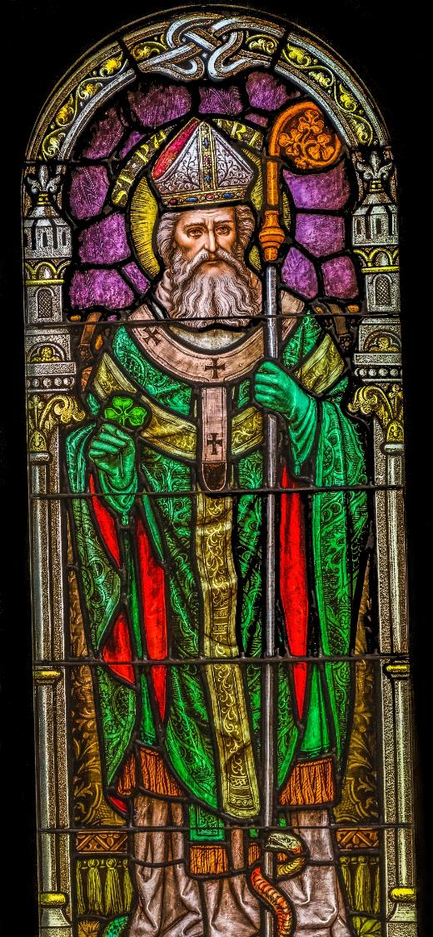
Notes:
Upon dreaming that the ship in which he was to escape was ready, he fled his enslaver and found passage to Britain. There he came near to starvation and suffered a second brief captivity before he was reunited with his family. St. Patrick could’ve easily stayed with his family, but he heard the voice of the Irish people in a vision begging him to return to Ireland.

Slide 12
St. Patrick and hopeful perseverance
““Daily I expect murder, fraud, or captivity,
but I fear none of these things because of the promise of heaven.”
(St. Patrick, The Confessions)
DIOCESE OF CORK & ROSS Lent 2024
Notes:
The tribes in Ireland were callous and violent and did not appreciate St. Patrick’s attempt to share the Good News. They tried to force him out in any way they could. In his writings, St. Patrick confessed, “Daily I expect murder, fraud, or captivity, but I fear none of these things because of the promise of heaven.”

Slide 13
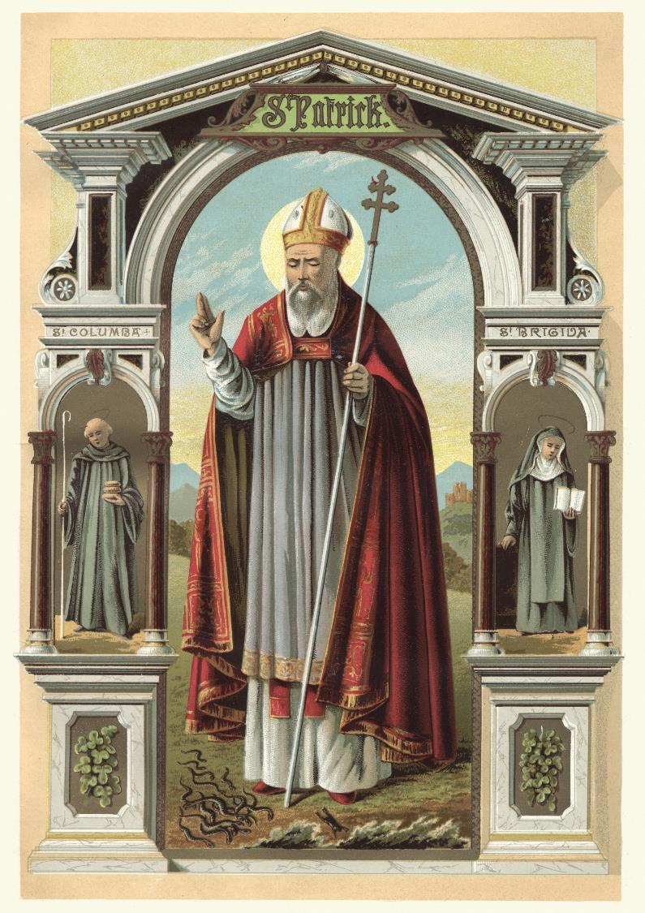
Notes:
St. Patrick’s perseverance paid off. He focused on the promises of God, and in doing so became one of the greatest disciple makers of all time.

Slide 14
Reflection
What can we learn from St. Patrick today?
How can I be a disciple maker like St. Patrick?
DIOCESE OF CORK & ROSS Lent 2024
Notes:
Spend some time reflecting and sharing your thoughts on these questions.

Slide 15
Prayer
Christ with me, Christ before me,
Christ behind me, Christ in me,
Christ beneath me, Christ above me,
Christ on my right, Christ on my left,
Christ when I lie down, Christ when I sit down,
Christ when I arise,
Christ in the heart of everyone who thinks of me,
Christ in the mouth of everyone who speaks of me,
Christ in every eye that sees me,
Christ in every ear that hears me.
DIOCESE OF CORK & ROSS Lent 2024
Notes:
Spend some time in silence, then pray our prayer together. Bring any other petitions to God as the Spirit prompts you.

Slide 16
Hope in action
St. Patrick took every opportunity to witness to God’s love and mercy; let us do the same this week.
St. Patrick forgave those who persecuted him, and even spent his life in service to them bringing them the Gospel. Are there people in our lives whom we need to forgive?
Pray for Christians who are being persecuted because of their faith.
DIOCESE OF CORK & ROSS Lent 2024
Notes:
Is there something you would like to do in response to what you have heard and reflected on during this gathering?

