Slide 1
Finding hope in a hopeless world
Session 7 – Holy Week and Easter Triduum
“Easter is like Christmas; it’s just for children.”
DIOCESE OF CORK & ROSS Lent 2024
Notes:
All that Jesus did and taught, from the beginning until the day when he was taken up to heaven, is to be seen in the light of the mysteries of Christmas and Easter. There is a temptation to sentimentalise both Christmas and Easter. We can reduce these celebrations to opportunities for taking holidays, meeting with family and friends, and feasting, all of which is important, but these are not the central reasons why we celebrate. Easter isn’t just about eggs, bunnies and chocolate. Does Jesus’s life, death and resurrection give us hope?

Slide 2
Welcome and Prayer
Take a moment to greet each other.
What stayed with you from last week’s gathering?
How did you put hope into action?
DIOCESE OF CORK & ROSS Lent 2024

Slide 3
Listening to God’s Word
“If Christ has not been raised, your faith is futile, and you are still in your sins. Then those also who have died in Christ have perished. If for this life only we have hoped in Christ, we are of all people most to be pitied. But in fact Christ has been raised from the dead, the first fruits of those who have died. For since death came through one man, the resurrection of the dead has also come through one man; for as all die in Adam, so all will be made alive in Christ.”
(1 Corinthians 15:17-22)
DIOCESE OF CORK & ROSS Lent 2024
Notes:
Spend a few moments reading and reflecting on this scripture. What is God saying to you? What would you like to say in response?

Slide 4
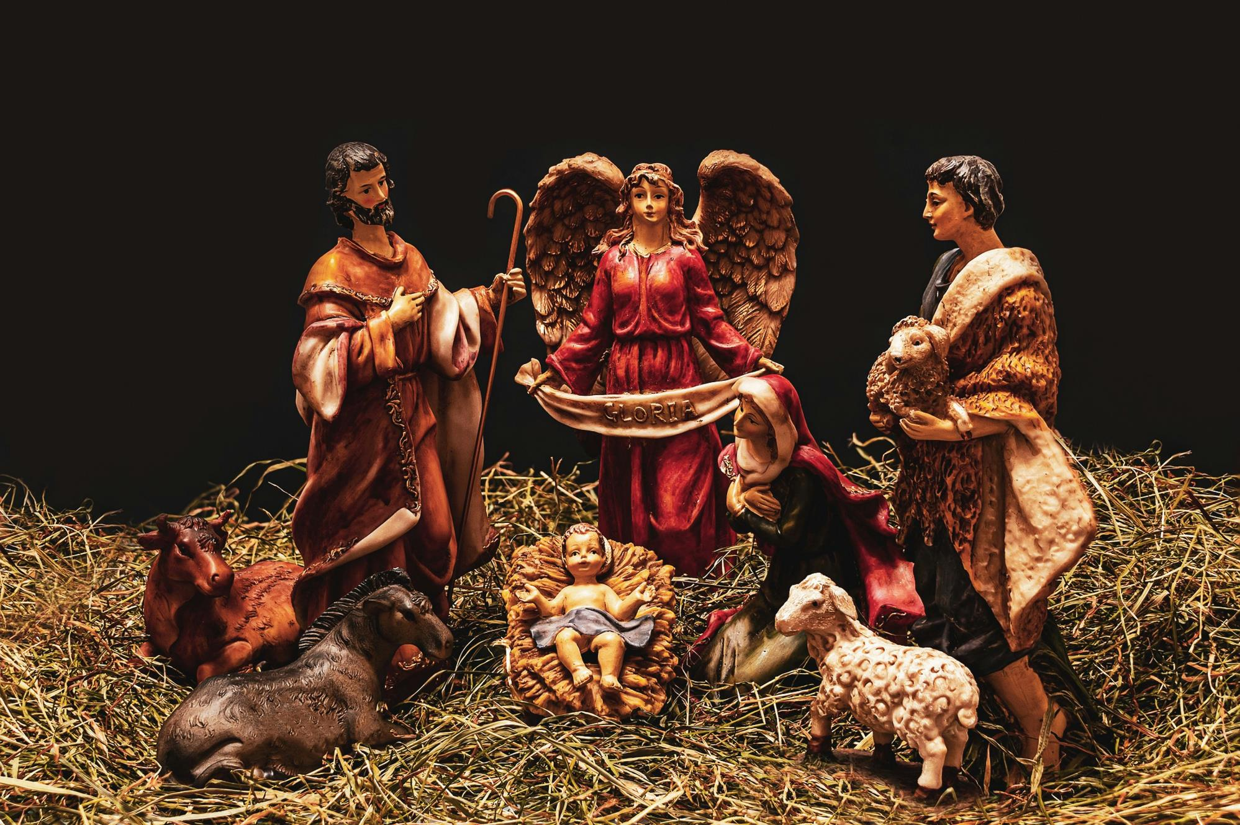
Notes:
Jesus became fully human to that He could save us from our sins. The humanity that Christ assumed was complete: he took to himself all that it means to be human. Jesus was conceived by the Holy Spirit and born of the Virgin Mary. Although his conception was miraculous, his birth was typically human: Mary “gave birth to her firstborn son and wrapped him in swaddling cloths and laid him in a manger, because there was no place for them in the inn” (Luke 2:7).

Slide 5
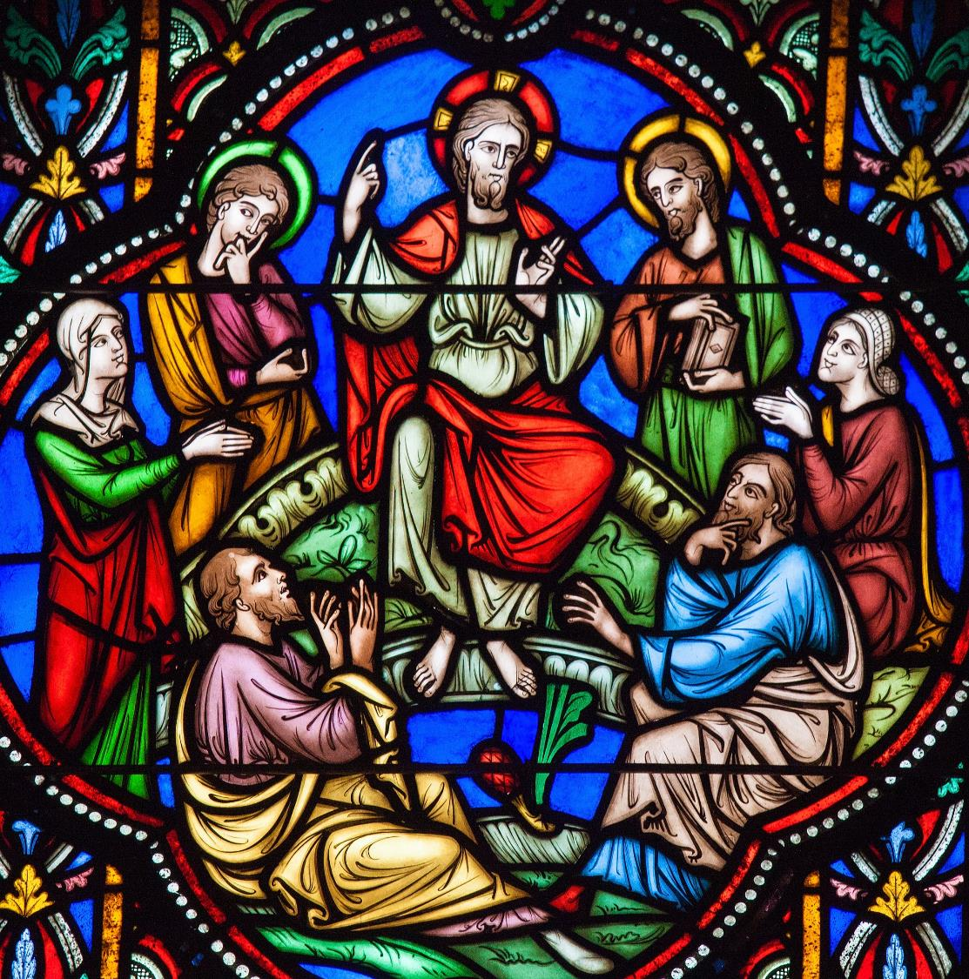
Notes:
In his humanity, Jesus experienced ordinary human growth and development. He “increased in wisdom and in stature and in favor with God and man” (Luke 2:52). Jesus grew intellectually, physically, spiritually, and relationally. The human nature that Jesus assumed in his incarnation was free from any stain of sin or corruption, but it nevertheless possessed all the marks of ordinary humanity. He experienced hunger, thirst, grew tired and experienced the full range of human emotions.
561 "The whole of Christ's life was a continual teaching: his silences, his miracles, his gestures, his prayer, his love for people, his special affection for the little and the poor, his acceptance of the total sacrifice on the Cross for the redemption of the world, and his Resurrection are the actualization of his word and the fulfillment of Revelation" John Paul II, CT 9).

Slide 6
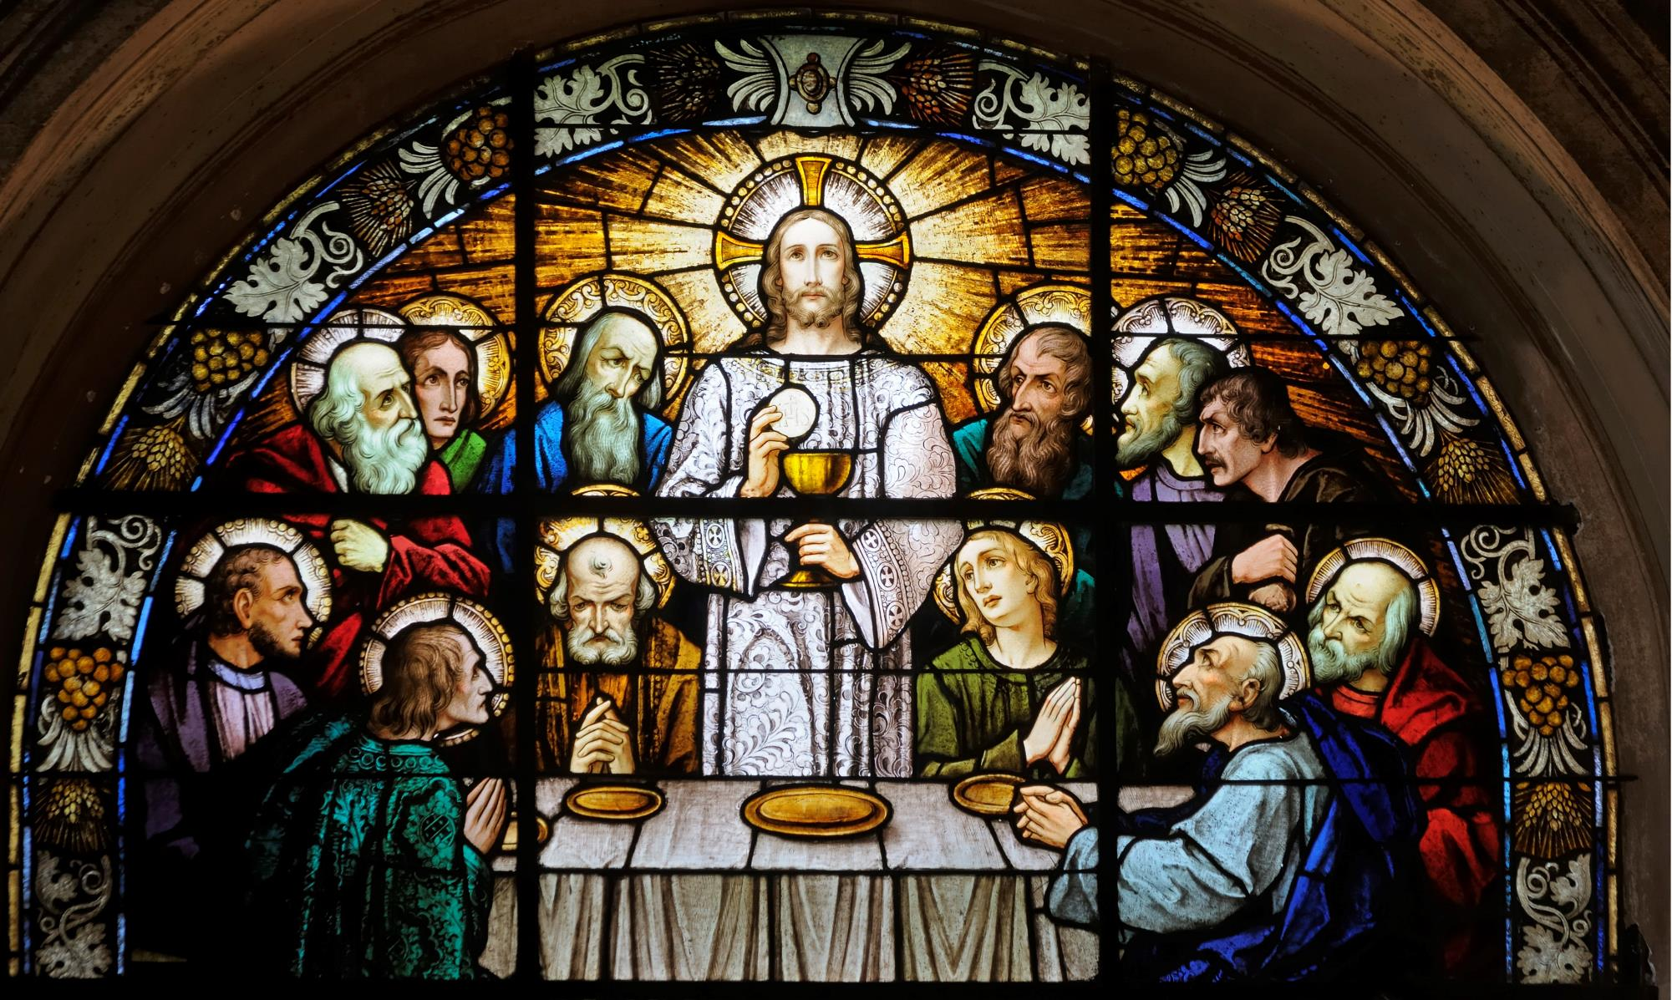
Notes:
Jesus entrusted the Eucharist to His Church. At every Mass, we consume Jesus’s resurrected, glorified body under the appearance of bread and wine. We eat the flesh and drink the blood of the God who became man, died, and rose again. The body that we eat is the same body that hung on the cross, lay in the tomb, and then rose from the dead. That body is also the same body that passed through walls, that could be in Emmaus one minute and Jerusalem the next, and then ascended into heaven to sit at the right hand of the Father.

Slide 7
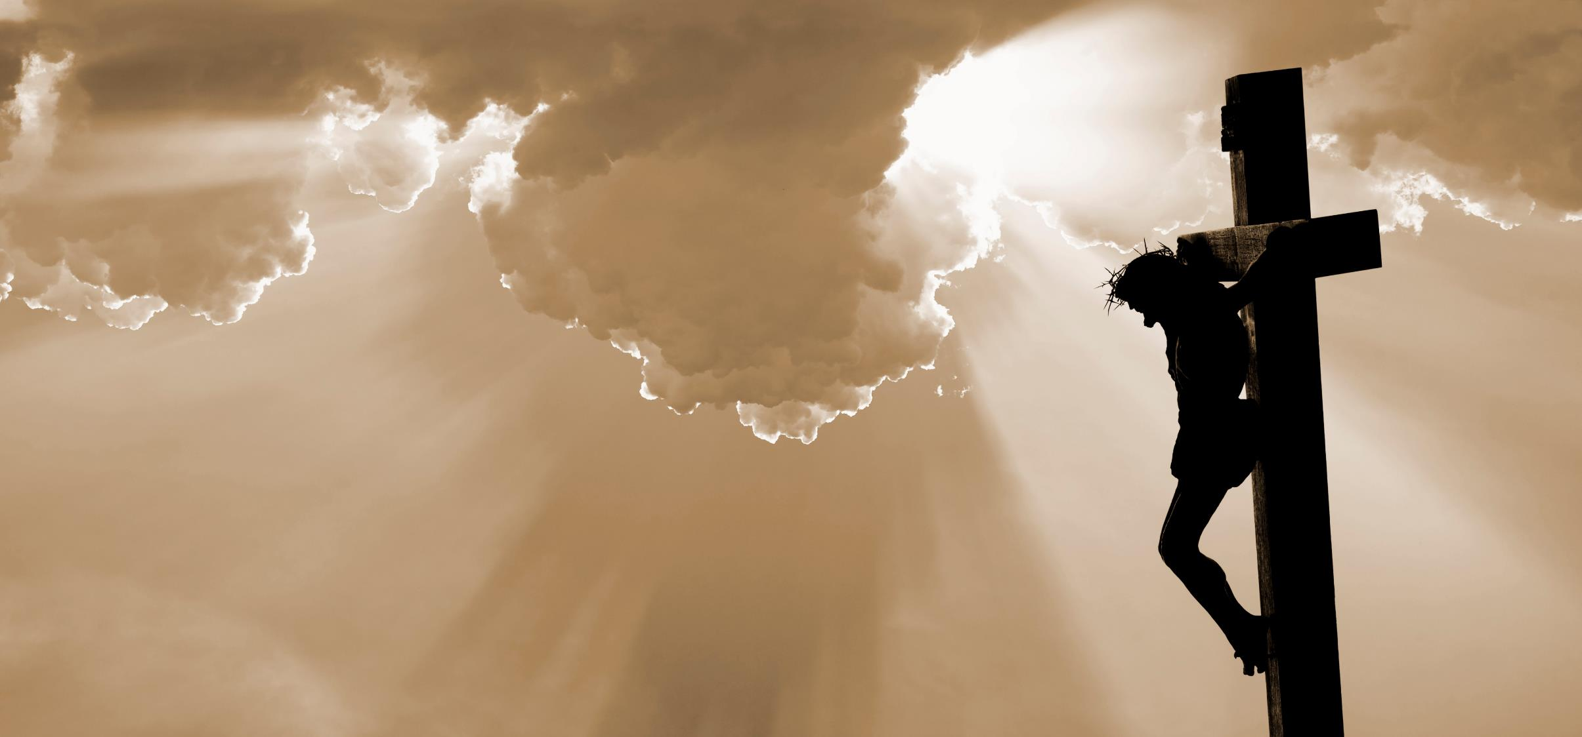
Notes:
The life, death and resurrection of Jesus brings us hope. Nothing enters our lives that is not under the sovereign and absolute reign of Jesus. No matter what happens in our lives, God wills to bring good out of it:

Slide 8
Hope in Jesus’s life, death and resurrection
“We know that all things work together for good
for those who love God,
who are called according to his purpose.”
(Romans 8:28)
DIOCESE OF CORK & ROSS Lent 2024
Notes:
Spend some time reading and reflecting on this scripture. Have you experienced this in your life?

Slide 9
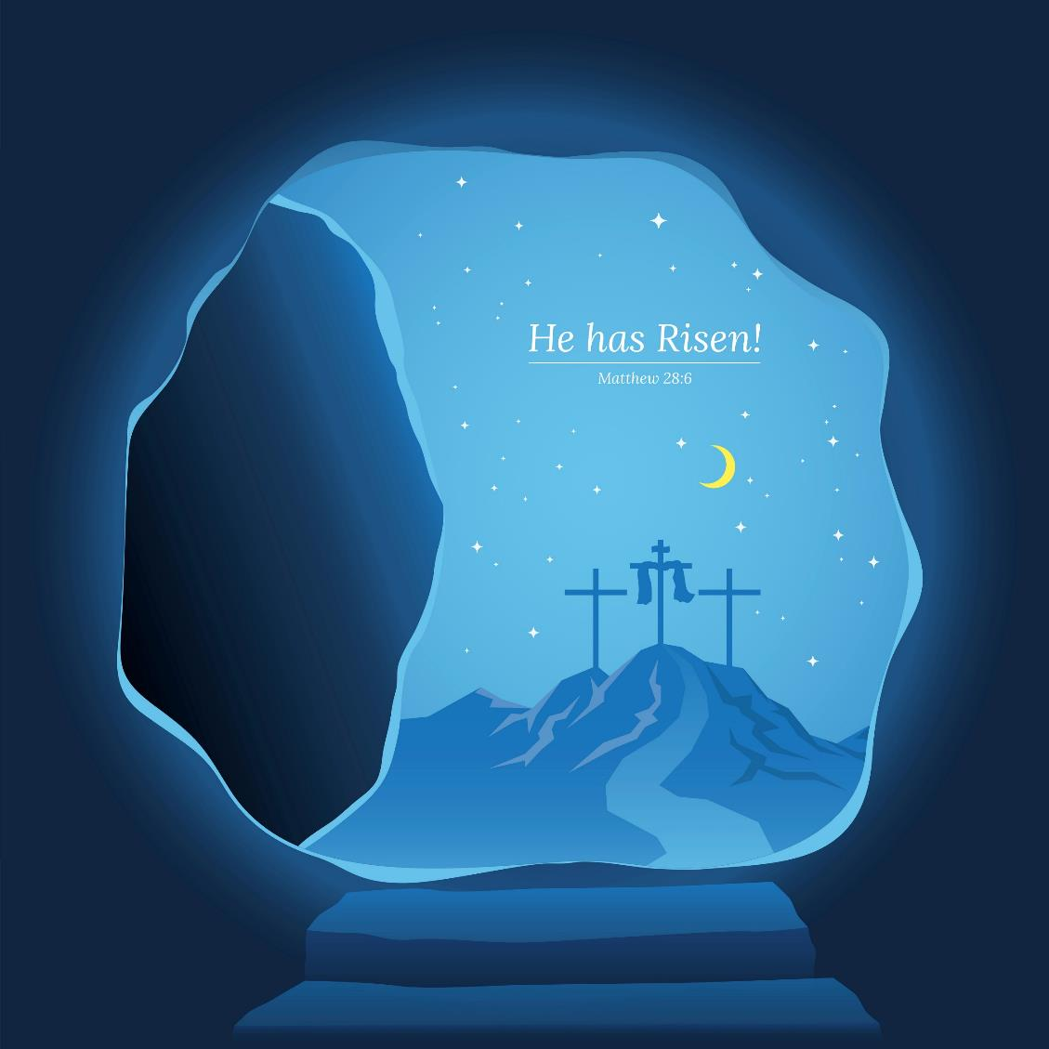
Notes:
Jesus’s resurrection is the guarantee that through faith in him, we too will one day be raised to new life with new and eternal bodies.

Slide 10
Jesus’s life, death and resurrection explains our hope
“For since death came through a man,
the resurrection of the dead comes also through a man.
For as in Adam all die,
so, in Christ all will be made alive.”
(1 Corinthians 15:21-22)
DIOCESE OF CORK & ROSS Lent 2024
Notes:
Our solidarity in humanity with Adam means that we can also stand in solidarity with Christ.

Slide 11
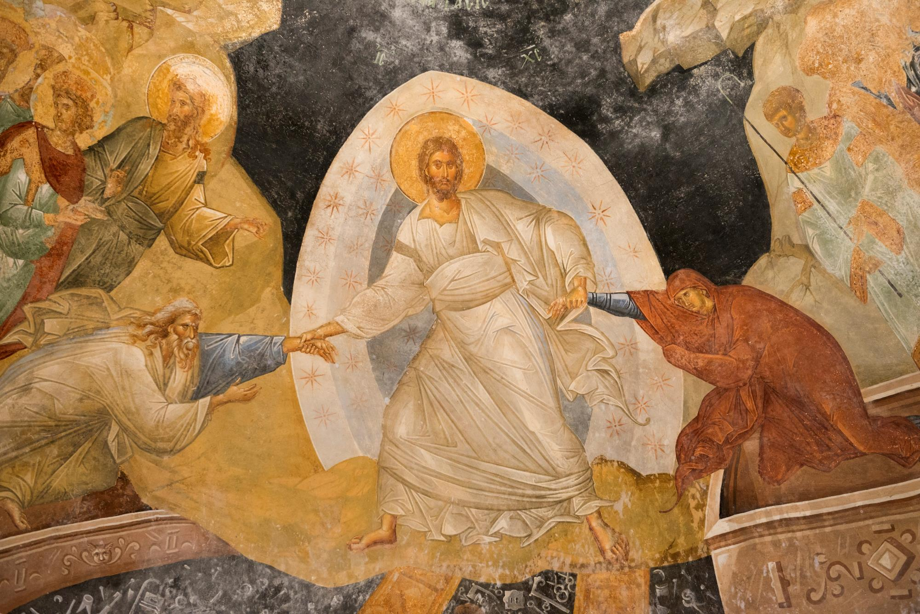
Notes:
And here’s the most glorious miracle of the incarnation of the Son of God. In choosing to bind humanity together in the tragedy of Adam’s sin, God made a way possible for us to be eternally bound together with him in Jesus.

Slide 12
Notes:
Jesus’s resurrection completes our hope. No matter what trials you may be going through, take heart.

Slide 13
Notes:
Easter approaches, and with it a reminder that trial, sorrow, sickness, and death is not the final word for us. But rather, because He lives, we also will live!

Slide 14
Prayer
“Today, as pilgrims in search of hope,
we cling to you, Risen Jesus.
We turn our backs on death and open our hearts to you,
for you are Life itself.”
(Pope Francis, 2020)
DIOCESE OF CORK & ROSS Lent 2024
Notes:
Spend some time in quiet prayer as we come to the last of our sessions together.
Give thanks for all that the Holy Spirit has revealed to you, and for the time we shared together.
Let us pray with Pope Francis.

Slide 15
Hope in action
Is there something you would like to do in response to what you have heard and reflected on during this gathering?
Spend some time reflecting on the death and resurrection of Jesus
and what that means for you.
Bring some Easter water into your home
and place it where people can bless themselves.
DIOCESE OF CORK & ROSS Lent 2024

