Slide 1
Finding hope in a hopeless world
Session 5 – 4th Week of Lent
Is it wrong to be joyful when there is so much suffering today?
DIOCESE OF CORK & ROSS Lent 2024
Notes:
The 4th Sunday of Lent is known as Laetare Sunday. Laetare is the Latin word for rejoice, which comes from the Entrance Antiphon at Mass: “Rejoice, Jerusalem, and all who love her. Be joyful, all who were in mourning; exult and be satisfied at her consoling breast.” We are encouraged to rejoice, be joyful, and exult, but is it wrong to be joyful when there is so much suffering today?

Slide 2
Welcome and Prayer
Spend a few minutes greeting each other and sharing:
What stayed with you from last week’s gathering?
How did you put your reflection into action?
DIOCESE OF CORK & ROSS Lent 2024
Notes:
We will now continue with a breath awareness activity leading into our prayer time…
Breath awareness activity and prayer to the Holy Spirit
Sit comfortably and close your eyes... Take a few moments to simply be…. Notice whatever is being experienced in the moment - sounds, physical sensations, thoughts, feelings - without trying to do anything about it… Continue like this a little while, allowing yourself to settle down…
Bring your attention to your breath. Simply notice your breath as it moves in and out as your body inhales and exhales... Notice how your breath moves in and out automatically, effortlessly… Don’t try to change it in any way... Notice all the details of the experience of breathing - the feeling of the air moving in and out of your nose, the way your body moves as it breathes, etc.
Let all of your experiences - thoughts, emotions, bodily sensations - come and go in the background of your awareness of your breath... Notice how all of your experiences - thoughts, emotions, bodily sensations, awareness of sounds and smells - come automatically and effortlessly like the breath…
Bring your attention to breathing in… as you breathe in invite the Holy Spirit, the Spirit of hope, the Spirit of life, the Spirit of love into yourself… Come, Holy Spirit. Continue to call on the Holy Spirit in the silence of your hearts… God is always present to us… in this time we are inviting ourselves to become more present to Him…
Now we turn our attention to breathing out… what sort of a day have you had so far today… perhaps you have been very busy and this is your first opportunity to sit down… perhaps you have left so many chores and things to do behind you… we bring with us all our hopes and dreams, our worries and cares, and hand them over to our Heavenly Father confident that He loves us and holds us tenderly in His hands…
As you breathe in… welcome the Holy Spirit… as you breathe out… hand over your life to God who wills the best for you…
Come, Holy Spirit. Teach us, lead us and guide us during this time together. May we come to know God the Father’s love, mercy and compassion in a deeper way, and may we be filled with the hope that comes from knowing Jesus. We make our prayer, through Christ, our Lord. Amen.

Slide 3
Listening to God’s Word
“Rejoice in the Lord always; again I will say, rejoice. Let your gentleness be known to everyone. The Lord is near. Do not worry about anything, but in everything by prayer and supplication with thanksgiving let your requests be made known to God. And the peace of God, which surpasses all understanding, will guard your hearts and your minds in Christ Jesus.” (Philippians 4:4-8)
DIOCESE OF CORK & ROSS Lent 2024
Notes:
Someone in the group may wish to read our Scripture piece. Then we will pause for a few moments and invite a second reader to read the same text. Ask if anyone would like to share their thoughts on God’s word. Please pause the video until this section is completed.

Slide 4
Finding joy in hope
“The joy of the Gospel fills the hearts and lives of all who encounter Jesus. Those who accept his offer of salvation are set free from sin, sorrow, inner emptiness and loneliness. With Christ joy is constantly born anew.” (Pope Francis, The Joy of the Gospel)
DIOCESE OF CORK & ROSS Lent 2024

Slide 5
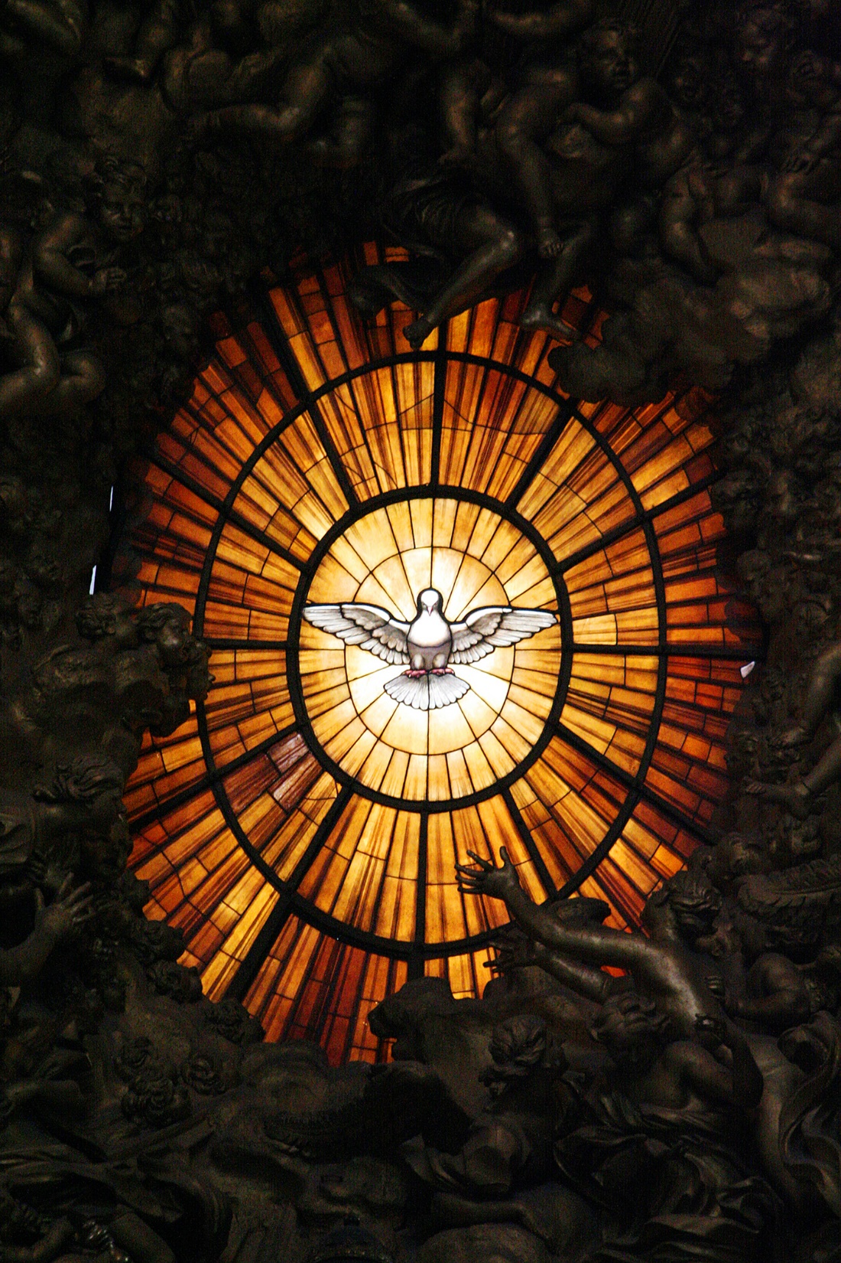
Joy is a grace and a gift of the Holy Spirit, not just positive emotions or feeling cheerful. We choose to love God, and we choose to love our neighbor. We find joy in that choice.

Slide 6
Notes:
We don’t have to feel joy to be joyful. We can be joyful even when we are suffering, because the joy of a Christian is a “joy in hope.”
(Pope Francis)

Slide 7
Notes:
What is Christian hope? It is the gift by which we desire heaven as our happiness, placing our trust in Christ’s promises and relying not on our own strength, but on the grace of the Holy Spirit.

Slide 8
Finding joy in hope
“Truly, truly, I say to you, you will weep and lament, but the world will rejoice; you will be sorrowful, but your sorrow will turn into joy.” (John 16:20)
DIOCESE OF CORK & ROSS Lent 2024

Slide 9
Notes:
Life is filled with moments of joy and despair. We all experience times of sadness, however, these words from Jesus remind us that even in times of sorrow, there is an opportunity for transformation and joy.

Slide 10
Finding joy in hope
When our life on earth is ended, we hope we will hear these words: “Well done, good and faithful servant; you have been faithful over a little, I will set you over much; enter into the joy of your master.” (Matthew 25:23)
DIOCESE OF CORK & ROSS Lent 2024

Slide 11
Reflection
Who supports you in your darkest of times?
Have you ever experienced joy in the midst of suffering?
Do you allow Jesus to walk with you and carry you?
DIOCESE OF CORK & ROSS Lent 2024
Notes:
Spend some time reflecting on and sharing your responses to these questions.

Slide 12
Prayer
There are times, O Lord when I feel a deep sense of unrest. Trials and tribulations beset me, and I do not know where to turn. I cannot see the reason why suffering must exist, but I trust in your plan. I pray that you will guide me in all ways and help me to make the best of the situation. I pray that you bring me the peace and joy that I seek in life. Amen.
DIOCESE OF CORK & ROSS Lent 2024
Notes:
Spend some time in silent, then pray our prayer together. Bring any other petitions to God as the Spirit prompts you.

Slide 13
Hope in action
Is there something you would like to do in response to what you have heard and reflected on during this gathering?
Give thanks for all the things that bring you joy.
How will you share your joy with others?
DIOCESE OF CORK & ROSS Lent 2024

