Slide 1
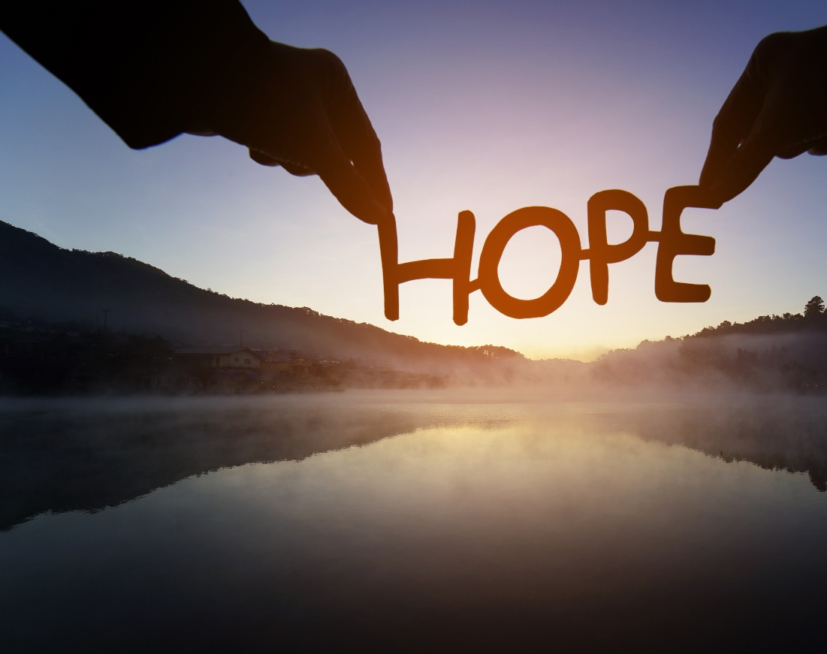
Finding hope in a hopeless world
Session 4 – 3rd Week of Lent
“The human person is the worst thing to happen to the world.” Should we hope in each other?
DIOCESE OF CORK & ROSS Lent 2024
Notes:
Session 4 – 3rd Week of Lent – “The human person is the worst thing to happen to the world.” This statement was made by a primary school teacher to second class students. Do we believe this to be true? Should we hope in each other?

Slide 2
Welcome and Prayer
Spend a few minutes greeting each other and sharing:
What stayed with you from last week’s gathering?
How did you put your reflection into action?
DIOCESE OF CORK & ROSS Lent 2024
Notes:
We will now continue with a breath awareness activity leading into our prayer time…
Breath awareness activity and prayer to the Holy Spirit
Sit comfortably and close your eyes... Take a few moments to simply be…. Notice whatever is being experienced in the moment - sounds, physical sensations, thoughts, feelings - without trying to do anything about it… Continue like this a little while, allowing yourself to settle down…
Bring your attention to your breath. Simply notice your breath as it moves in and out as your body inhales and exhales... Notice how your breath moves in and out automatically, effortlessly… Don’t try to change it in any way... Notice all the details of the experience of breathing - the feeling of the air moving in and out of your nose, the way your body moves as it breathes, etc.
Let all of your experiences - thoughts, emotions, bodily sensations - come and go in the background of your awareness of your breath... Notice how all of your experiences - thoughts, emotions, bodily sensations, awareness of sounds and smells - come automatically and effortlessly like the breath…
Bring your attention to breathing in… as you breathe in invite the Holy Spirit, the Spirit of hope, the Spirit of life, the Spirit of love into yourself… Come, Holy Spirit. Continue to call on the Holy Spirit in the silence of your hearts… God is always present to us… in this time we are inviting ourselves to become more present to Him…
Now we turn our attention to breathing out… what sort of a day have you had so far today… perhaps you have been very busy and this is your first opportunity to sit down… perhaps you have left so many chores and things to do behind you… we bring with us all our hopes and dreams, our worries and cares, and hand them over to our Heavenly Father confident that He loves us and holds us tenderly in His hands…
As you breathe in… welcome the Holy Spirit… as you breathe out… hand over your life to God who wills the best for you…
Come, Holy Spirit. Teach us, lead us and guide us during this time together. May we come to know God the Father’s love, mercy and compassion in a deeper way, and may we be filled with the hope that comes from knowing Jesus. We make our prayer, through Christ, our Lord. Amen.

Slide 3
Listening to God’s Word
“So, God created man in his own image, in the image of God he created him; male and female he created them.” (Genesis 1:27)
“For we are God’s handiwork, created in Christ Jesus to do good works, which God prepared in advance for us to do.”
(Ephesians 2:10)
DIOCESE OF CORK & ROSS Lent 2024
Notes:
Someone in the group may wish to read our Scripture piece. Then we will pause for a few moments and invite a second reader to read the same text. Ask if anyone would like to share their thoughts on God’s word. Please pause the video until this section is completed.

Slide 4
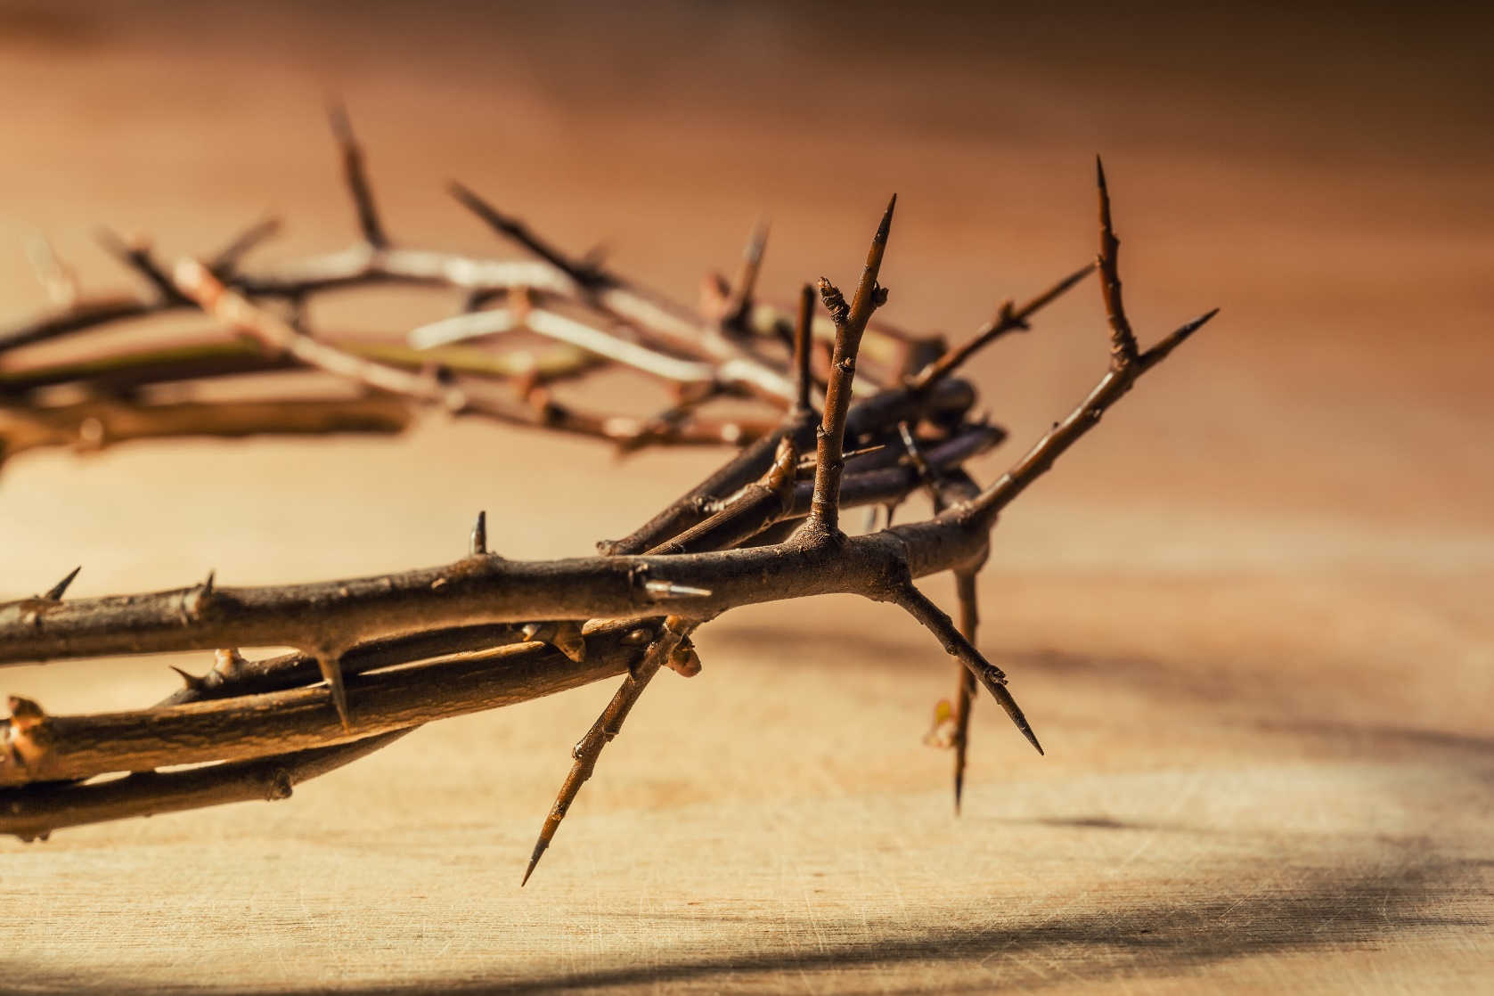
Hope in the human person
DIOCESE OF CORK & ROSS Lent 2024
Notes:
We are created in God’s image and likeness. We are God’s handiwork, created in Christ Jesus to do good works, which God prepared in advance for us to do.” (Ephesians 2:10)
We are capable of great good and yet we still hurt each other. We have major conflicts throughout the world. Our news is full of accounts of violence and the suffering which we cause each other. So, how can we continue to hope in our fellow brothers and sisters?

Slide 5
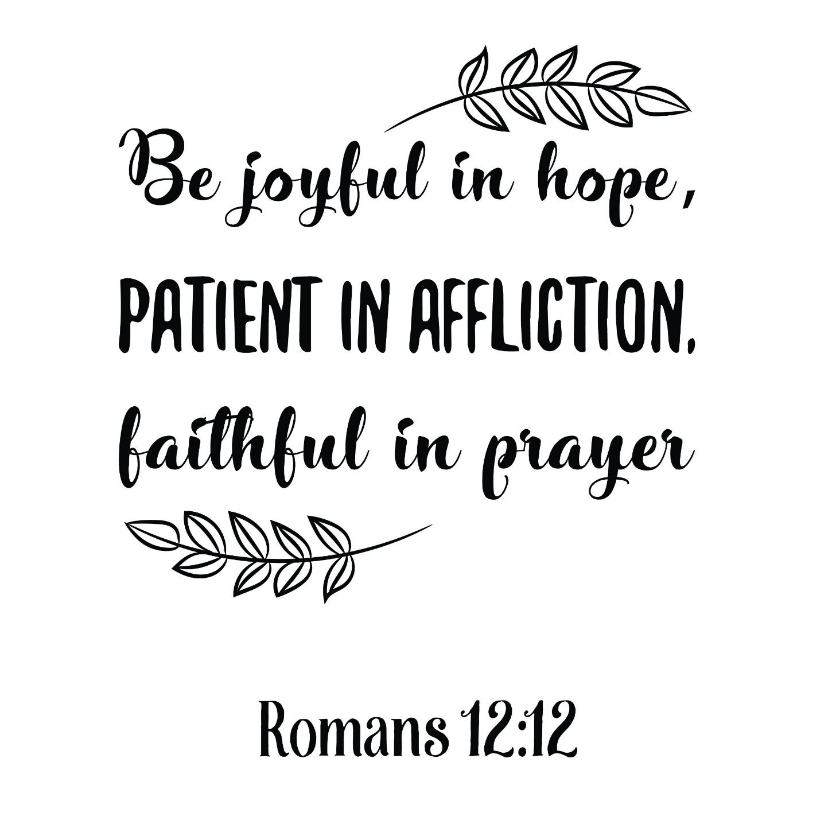
DIOCESE OF CORK & ROSS Lent 2024
Notes:
Hope that is joyful. St. Paul invites us to “Rejoice in hope…” (Romans 12:12). We hope because God’s infinite love and mercy extends to all.
Imagine the joyful hope of a child waiting for their birthday or Christmas. This is the type of joyful hope that will help us face the cynicism, sarcasm, and pessimism of the world.
What does joyful hope look like in your life?

Slide 6
DIOCESE OF CORK & ROSS Lent 2024
Notes:
Hope that is patient. We live in a world that has created an illusion of instants, but hope means to trust and patiently wait for God to act in God’s time.
What does patient hope look like in your life?

Slide 7
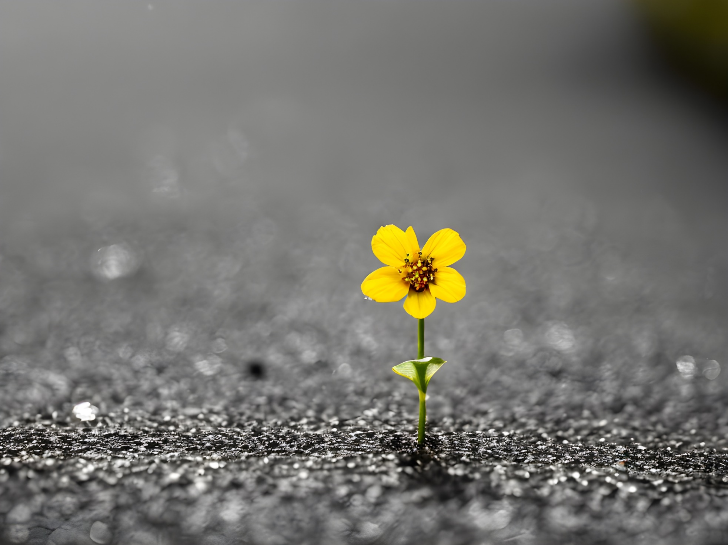
DIOCESE OF CORK & ROSS Lent 2024
Notes:
Hope that is resilient. A resilient person is one who overcomes challenges and is flexible. A resilient hope is one that endures change, challenge, and disappointment. Such a hope overcomes adversity.
What does resilient hope look like in your life?

Slide 8
Reflection
How would you describe your hope, or desire for hope, right
now: Patient hope? Joyful hope? Resilient hope?
What gives you reason for hope?
DIOCESE OF CORK & ROSS Lent 2024
Notes:
Have there been moments or practices of prayer - in public liturgy and/or times of silence and contemplation - that nurtured hope in you?

Slide 9
Prayer
“And not only that, but we also boast in our sufferings, knowing that suffering produces endurance, and endurance produces character, and character produces hope, and hope does not disappoint us, because God’s love has been poured into our hearts through the Holy Spirit that has been given to us.” (Romans 5:3-5)
DIOCESE OF CORK & ROSS Lent 2024
Notes:
Spend some time in quiet prayer with the following Scripture text:
What is God saying to you? How would you like to respond to Him?

Slide 10
Prayer
DIOCESE OF CORK & ROSS Lent 2024
Notes:
St. Paul describes you as our hope in his first Letter to Timothy. Lord, help me to hear you saying, “I am your hope” over all the other voices. Lord, your word says, you are the hope for hopeless so I'm running to you with both hands outstretched and grabbing on to you. Fill me up with hope and give me a tangible reminder today that hope is an unbreakable spiritual lifeline (Hebrews 6:19-20). God, you know those things in my heart that I barely dare to hope for, today I give them to you, I entrust them to you, because I know that you can do more than I could ever guess, imagine or request in wildest dreams (Eph 3:20). God, you are my hope and I trust you. Amen.

Slide 11
Hope in action
Is there something you would like to do in response to what you have heard and reflected on during this gathering?
How can I be a channel or messenger of peace?
Commit to pray for those who are struggling, who have no hope.
DIOCESE OF CORK & ROSS Lent 2024

