Slide 1
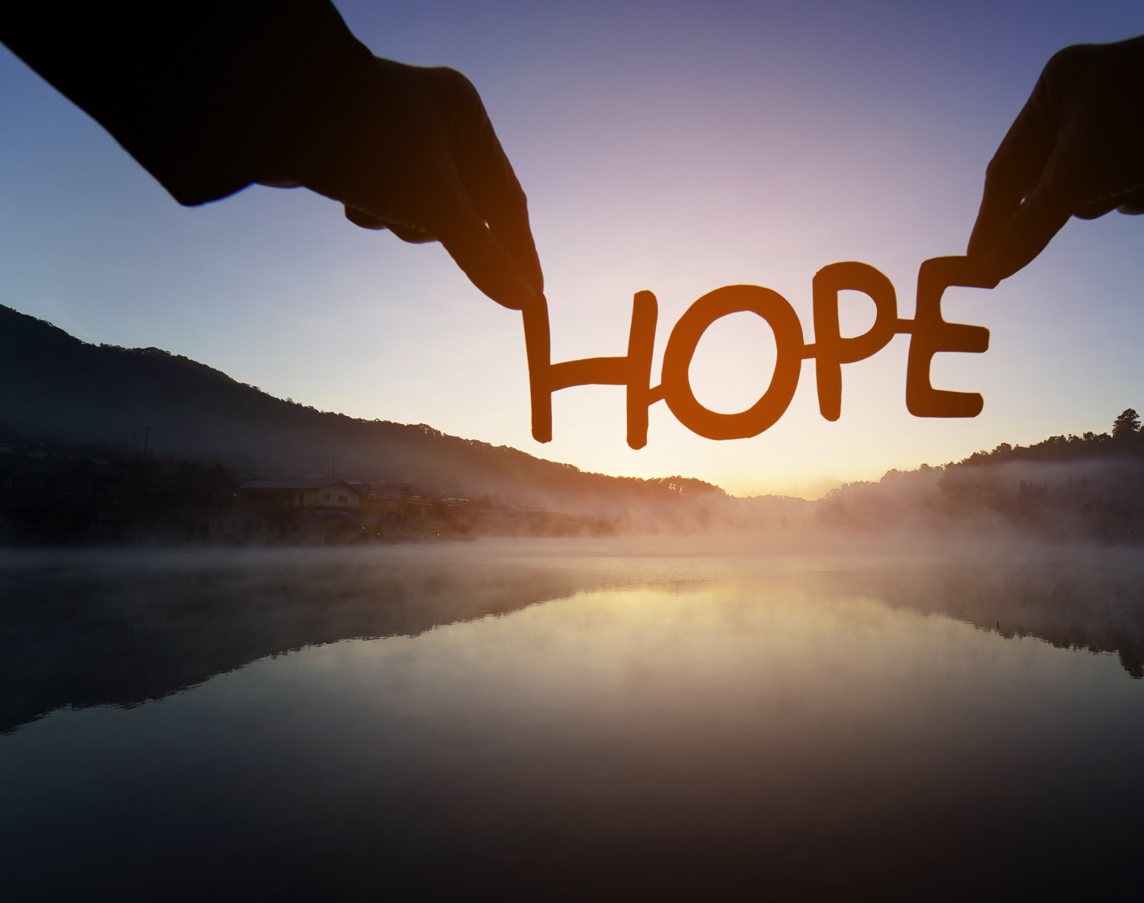
Finding hope in a hopeless world
Session 2 – 1st Week of Lent
What does Baptism mean to me?
Does it make a difference in my life?
DIOCESE OF CORK & ROSS Lent 2024
Notes:
The readings from the first Sunday of Lent teach us about the sacrament of baptism. In the second reading, St. Peter reminds us that just as God saved Noah and his family through the waters of the flood, now God saves us through the waters of Baptism. Jesus accomplished this by becoming fully human while remaining fully God. His life, death and resurrection conquered death and saves us from our sins. But do I even think about my baptism? What does baptism mean to me? Does it make a difference in my life?

Slide 2
Welcome and Prayer
Take a moment to greet each other.
What stayed with you from last week’s gathering?
How did you put hope into action?
DIOCESE OF CORK & ROSS Lent 2024
Notes:
Spend a few minutes greeting each other.
Share with one another:
What stayed with you from last week’s gathering?
How did you put hope into action? Was it easy or difficult?
We will now continue with a breath awareness activity leading into our prayer time…
Breath awareness activity and prayer to the Holy Spirit
Sit comfortably and close your eyes... Take a few moments to simply be…. Notice whatever is being experienced in the moment - sounds, physical sensations, thoughts, feelings - without trying to do anything about it… Continue like this a little while, allowing yourself to settle down…
Bring your attention to your breath. Simply notice your breath as it moves in and out as your body inhales and exhales... Notice how your breath moves in and out automatically, effortlessly… Don’t try to change it in any way... Notice all the details of the experience of breathing - the feeling of the air moving in and out of your nose, the way your body moves as it breathes, etc.
Let all of your experiences - thoughts, emotions, bodily sensations - come and go in the background of your awareness of your breath... Notice how all of your experiences - thoughts, emotions, bodily sensations, awareness of sounds and smells - come automatically and effortlessly like the breath…
Bring your attention to breathing in… as you breathe in invite the Holy Spirit, the Spirit of hope, the Spirit of life, the Spirit of love into yourself… Come, Holy Spirit. Continue to call on the Holy Spirit in the silence of your hearts… God is always present to us… in this time we are inviting ourselves to become more present to Him…
Now we turn our attention to breathing out… what sort of a day have you had so far today… perhaps you have been very busy and this is your first opportunity to sit down… perhaps you have left so many chores and things to do behind you… we bring with us all our hopes and dreams, our worries and cares, and hand them over to our Heavenly Father confident that He loves us and holds us tenderly in His hands…
As you breathe in… welcome the Holy Spirit… as you breathe out… hand over your life to God who wills the best for you…
Come, Holy Spirit. Teach us, lead us and guide us during this time together. May we come to know God the Father’s love, mercy and compassion in a deeper way, and may we be filled with the hope that comes from knowing Jesus. We make our prayer, through Christ, our Lord. Amen.

Slide 3
Listening to God’s Word
“Then Jesus came from Galilee to John at the Jordan, to be baptised by him. John would have prevented him, saying, “I need to be baptised by you, and do you come to me?” But Jesus answered him, “Let it be so now; for it is proper for us in this way to fulfill all righteousness.” Then he consented. And when Jesus had been baptised, just as he came up from the water, suddenly the heavens were opened to him, and he saw the Spirit of God descending like a dove and alighting on him. And a voice from heaven said, “This is my Son, the Beloved, with whom I am well pleased.””
(Matthew 3:13-17)
DIOCESE OF CORK & ROSS Lent 2024
Notes:
Someone in the group may wish to read our Scripture piece. Then we will pause for a few moments and invite a second reader to read the same text. Ask if anyone would like to share their thoughts on God’s word. Please pause the video until this section is completed.

Slide 4
Hope in our Baptism
In the sacrament (a sacred moment) a person is Christ-ened.
The day of Christening is not the end of a journey but the beginning of a new life.
DIOCESE OF CORK & ROSS Lent 2024
Notes:
Christening can be a more powerful word than baptism. In the sacrament (a sacred moment) a person is Christ-ened. What does that mean? Christ is a title that means “the anointed one.” In our Gospel reading, which we just reflected upon, Jesus was anointed by the Holy Spirit (he saw the Spirit of God descending like a dove and alighting on him). At our Baptism, we, too, are anointed, twice actually – once with the oil of Baptism and once with the oil of Chrism. The Holy Spirit comes upon us when the water is poured, we are addressed by name and the following words are said: “I baptise you in the name of the Father, and of the Son, and of the Holy Spirit.”
In that moment, we become Christians, Christ-ened. We become children of God in Christ. What does a Christian look like? What are their characteristics and qualities?

Slide 5
Reflection
If you were on trial for being a Christian, is there enough evidence to convict you?
DIOCESE OF CORK & ROSS Lent 2024
Notes:
If you were on trial for being a Christian, is there enough evidence to convict you? Spend some time discussing this question. Let it sit with you. Imagine a modern-day court…
What sort of evidence would be admitted?
Who would you call on in your defence?
Who would stand beside you as your counsellor?

Slide 6
The implications of being Christened
“Jesus wants evangelisers who proclaim the good news not only with words, but above all by a life transfigured by God’s presence.”
(Pope Francis)
We have been Christened.
We are members of His Body on earth.
We are called to continue His mission.
DIOCESE OF CORK & ROSS Lent 2024
Notes:
Spend a few moments in silence reading and reflecting on these ideas.
What does a life transfigured by God’s presence look like?
What does it mean to be a member of Christ’s Body on earth.
What is the mission that we are called to continue?

Slide 7
Jesus is counting on you…
St Teresa of Avila said:
He has no hands but my hands to do His work today.
He has no feet but my feet to lead people in His way.
He has no tongue but my tongue to tell people how He died.
He has no help but my help to lead people to His side.
DIOCESE OF CORK & ROSS Lent 2024
Notes:
Spend some time reflecting on these thoughts.
St. John Henry Newman wrote:
“God has created me to do Him some definite service. He has committed some work to me which He has not committed to another. I have my mission. I may never know it in this life, but I shall be told it in the next. I am a link in a chain, a bond of connection between persons. He has not created me for naught. I shall do good; I shall do His work. I shall be an angel of peace, a preacher of truth in my own place, while not intending it if I do but keep His commandments.”
Can Jesus count on you? What good will you do today?

Slide 8
Prayer
God alone can give faith, but you can offer witness.
God alone can give hope, but you can give confidence to others.
God alone can give love, but you can pass it on to others.
God alone can give peace, but you can work for unity.
God alone can give power, but you can sustain somebody who is feeling low.
God alone is the way, but you can show it to others.
God alone is the light, but you can make it shine for others.
God alone is life, but you can give others a taste for living.
God alone can do the impossible, but through you it becomes possible.
God alone is self-sufficient … but amazingly, God prefers to count on you.
Notes:
Take a few moments of silence and ask the Holy Spirit to be with you as you spend some time reflecting on the following:
God alone can give faith, but you can offer witness.
God alone can give hope, but you can give confidence to others.
God alone can give love, but you can pass it on to others.
God alone can give peace, but you can work for unity.
God alone can give power, but you can sustain somebody who is feeling low.
God alone is the way, but you can show it to others.
God alone is the light, but you can make it shine for others.
God alone is life, but you can give others a taste for living.
God alone can do the impossible, but through you it becomes possible.
God alone is self-sufficient … but amazingly, God prefers to count on you.
What do you want to say to Jesus? What does He say to you?
Is there anything you want to take with you from this time of prayer?

Slide 9
Hope in action
Is there something you would like to do in response to what you have heard and reflected on during this gathering?
What is my mission as a Christian?
How can I be the hands and feet of Jesus this week?
DIOCESE OF CORK & ROSS Lent 2024
Notes:
Spend some time in silence reflecting on these questions. They are your way to put hope into action this week. We invite you to make a commitment to the Lord to live out whatever the Lord has inspired you to do during the coming week.
Perhaps the words of St. John of the Cross may inspire you: “Where there is no love, put love - and you will find love.”
Where will you put love this week?

