Slide 1
Finding hope in a hopeless world
Session 1 – Ash Wednesday
Do I feel loved?
DIOCESE OF CORK & ROSS Lent 2024
Notes:
We live in a time that is marked by conflict. Our news is often filled with stories of violence, sudden deaths, natural disasters and other events which can make us feel hopeless. Yet, Pope Francis says that hope is essential: “Think for a moment. How can we live without hope? What would our days be like? Hope is the salt of our daily lives.”
Pope Francis is calling on each of us to be ‘pilgrims of hope,’ who carry the light of Christ into every situation. “Christ himself is our great light of hope and our guide in the night, because he is ‘the bright morning star’” (Christ is alive, paragraph 33). Lent is the perfect time to reflect on this as the days get longer and the light increases.
Over the next seven sessions we will reflect on hope in our lives from different viewpoints:
Hope in God’s love
Hope in our Baptism
Hope in our Saviour
Hope in the human person
Finding joy in hope
Hope in our Church
Hope in Christ’s death and resurrection
It is appropriate (although somewhat inconvenient!) that Ash Wednesday falls on Valentine’s Day this year. Ash Wednesday reminds us of God’s love for us. In the First Reading from the Book of Joel we are asked to “turn to the Lord your God again, for he is all tenderness and compassion, slow to anger, rich in graciousness and ready to relent.” It is God’s love and mercy that we celebrate first and foremost during Lent.
As you use this resource, please pause the video as you wish and spend time reflecting on God’s word, on the ideas, on the reflection questions and prayers as suits. This is not a resource to be rushed, but is an opportunity to be prompted by the Holy Spirit on hope in our lives.

Slide 2
Welcome and Prayer
Introduce yourselves
and spend a few minutes getting to know one another.
Let us begin our time of prayer together.
DIOCESE OF CORK & ROSS Lent 2024
Notes:
Spend a few minutes introducing yourselves to one another. You might like to use an icebreaker. Perhaps each person in the group could share their name with an adjective describing some aspect of their personality. The catch is that the adjective must begin with the first letter of their name. For example, merciful Mike, caring Carrie, loving Lisa etc. As you go around the circle, the next person has to remember the adjectives and names of those who went before them. Of course, we can help each other when we get stuck. It is a fun way to get to know each other. Please pause the video until after this exercise.
We will now continue with a breath awareness activity leading into our prayer time…
Breath awareness activity and prayer to the Holy Spirit
Sit comfortably and close your eyes... Take a few moments to simply be…. Notice whatever is being experienced in the moment - sounds, physical sensations, thoughts, feelings - without trying to do anything about it… Continue like this a little while, allowing yourself to settle down…
Bring your attention to your breath. Simply notice your breath as it moves in and out as your body inhales and exhales... Notice how your breath moves in and out automatically, effortlessly… Don’t try to change it in any way... Notice all the details of the experience of breathing - the feeling of the air moving in and out of your nose, the way your body moves as it breathes, etc.
Let all of your experiences - thoughts, emotions, bodily sensations - come and go in the background of your awareness of your breath... Notice how all of your experiences - thoughts, emotions, bodily sensations, awareness of sounds and smells - come automatically and effortlessly like the breath…
Bring your attention to breathing in… as you breathe in invite the Holy Spirit, the Spirit of hope, the Spirit of life, the Spirit of love into yourself… Come, Holy Spirit. Continue to call on the Holy Spirit in the silence of your hearts… God is always present to us… in this time we are inviting ourselves to become more present to Him…
Now we turn our attention to breathing out… what sort of a day have you had so far today… perhaps you have been very busy and this is your first opportunity to sit down… perhaps you have left so many chores and things to do behind you… we bring with us all our hopes and dreams, our worries and cares, and hand them over to our Heavenly Father confident that He loves us and holds us tenderly in His hands…
As you breathe in… welcome the Holy Spirit… as you breathe out… hand over your life to God who wills the best for you…
Come, Holy Spirit. Teach us, lead us and guide us during this time together. May we come to know God the Father’s love, mercy and compassion in a deeper way, and may we be filled with the hope that comes from knowing Jesus. We make our prayer, through Christ, our Lord. Amen.

Slide 3
Listening to God’s Word
“For God so loved the world that he gave his only Son, so that everyone who believes in him may not perish but may have eternal life.” (John 3:16)
DIOCESE OF CORK & ROSS Lent 2024
Notes:
Someone in the group may wish to read our Scripture piece. Then we will pause for a few moments and invite a second reader to read the same text. Sometimes when we hear a different voice, a different part of the text is brought to our attention. Ask if anyone would like to share their thoughts on God’s word. Please pause the video until this section is completed.

Slide 4
Hope in God’s love
“When Christianity says that God loves man, it means that God loves man: not that He has some ‘disinterested’ … concern for our welfare, but that, in awful and surprising truth, we are the objects of His love. You asked for a loving God: you have one.” (C.S. Lewis)
DIOCESE OF CORK & ROSS Lent 2024
Notes:
This is a quotation from C.S. Lewis, the author of The Chronicles of Narnia, amongst other books. This is an excerpt from a book entitled, “The Problem of Pain.” Someone from the group may wish to read it out loud. God loves us too much to leave us where we are. He wills the best for us. What could this look like in our lives?
C.S. Lewis – The Problem of Pain
https://www.cslewisinstitute.org/resources/reflections-august-2016/#:~:text=As%20C.S.,the%20objects%20of%20His%20love.

Slide 5
The implications of God’s love
God loves us not because we are lovable,
but because He is love.
God only wills what is best for us, because He is love.
He wants us to be transformed into a being of holy love like Himself.
He will settle for nothing less.
DIOCESE OF CORK & ROSS Lent 2024
Notes:
Spend a few moments in silence reading and reflecting on these ideas. What does God will for us? What is His greatest desire for us?

Slide 6
Reflection
Do I feel loved?
By whom?
How does that affect me?
DIOCESE OF CORK & ROSS Lent 2024
Notes:
Spend some time discussing these questions with one another. Please feel free to share anything which might be staying with you from what we have heard and discussed so far.

Slide 7
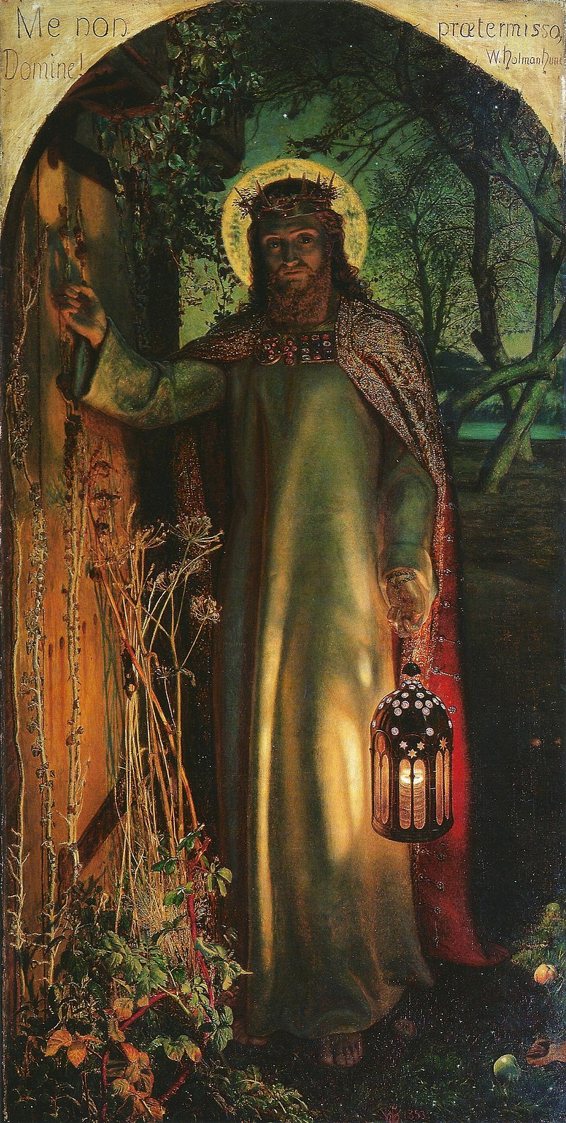
Jesus invites you into a deeper relationship this Lent…
What do you see in this painting?
What do you not see in this painting?
How do we open the door of our hearts?
DIOCESE OF CORK & ROSS The Light of the World - William Holman Hunt
Notes:
Spend some time together reflecting on the Light of the World painting by William Holman Hunt. The reflection questions are a prompt to go deeper.

Slide 8
Prayer
Come to a place of stillness and allow your mind to empty for a while… Imagine that Jesus is knocking on your door… imagine yourself opening the door and welcoming Him into your home…
Now imagine Jesus comes and sits beside you… Take some time to be in His Presence…
What do you want to say to Jesus? What does He say to you?
Is there anything you want to take with you from this time of prayer?
DIOCESE OF CORK & ROSS Lent 2024

Slide 9
Hope in action
Is there something you would like to do in response to what you have heard and reflected on during this gathering?
How can you open the door to Jesus this week?
How can you show others that they are loved?
DIOCESE OF CORK & ROSS Lent 2024
Notes:
Spend some time in silence reflecting on these questions. They are your way to put hope into action this week. We invite you to make a commitment to the Lord to live out whatever the Lord has inspired you to do during the coming week. Be gentle with yourselves. It is better to do small things with great love, as St. Therese of Lisieux taught us, rather than choosing great things and feeling that we have failed. God is infinitely compassionate and tender with us, may we be equally compassionate with ourselves.

